Slide 1
I/O BUSES

Slide 2
WHAT IS A BUS ?
Processor, main memory, and I/O devices are interconnected by means of a bus.
Bus provides a communication path for the transfer of data.
A bus protocol is the set of rules that govern the behavior of various devices connected to the bus, as to when to place information on the bus, when to assert control signals, etc.

Slide 3
I/O Buses :
Bus lines may be grouped into three types:
Data
Address
Control
Control signals specify:
Whether it is a read or a write operation.
Required size of the data, when several operand sizes (byte, word, long word) are possible.
Timing information to indicate when the processor and I/O devices may place data or receive data from the bus.

Slide 4
Types of io buses :
Schemes for timing of data transfers over a bus can be classified into:
Synchronous Bus
Asynchronous Bus

Slide 5
Synchronous Bus :
In a synchronous bus, all the devices are synchronised by a common clock, so all devices derive timing information from a common clock line of the bus.
A clock pulse on this common clock line defines equal time intervals.
In the simplest form of a synchronous bus, each of these clock pulse constitutes a bus cycle during which one data transfer can take place.

Slide 6
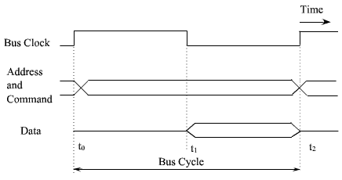
Synchronous Bus :

Slide 7
Synchronous Bus :
Let us consider the sequence of events during an input (read) operation.
At time t0, the master places the device address on the address lines and sends an appropriate command(read in case of input) on the command lines.
In any data transfer operation, one device plays the role of a master, which initiates data transfer by issuing read or write commands on the bus.

Slide 8
Synchronous Bus :
Normally, the processor acts as the master, but other device with DMA capability may also becomes bus master.
The device addressed by the master is referred to as a slave or target device.
The command also indicates the length of the operand to be read, if necessary.

Slide 9
Synchronous Bus :
The clock pulse width, t1 - t0, must be longer than the maximum propagation delay between two devices connected to the bus.
After decoding the information on address and control lines by slave, the slave device of that particular address responds at time t1.
The addressed slave device places the required input data on the data line at time.

Slide 10
Synchronous Bus :
At the end of the clock cycle, at time t2, the master strobes the data on the data lines into its input buffer.
The period t2- t1 must be greater than the maximum propagation delay on the bus plus the set up time of the input buffer register of the master.

Slide 11
Synchronous Bus :
A similar procedure is followed for an output operation. The master places the output data on the data lines when it transmits the address and command information.
At time t2, the addressed device strobe the data lines and load the data into its data buffer.

Slide 12
Multiple Cycle Transfer :
The simple design of device interface by synchronous bus has some limitations.
A transfer has to be completed within one clock cycle. The clock period, must be long enough to accommodate the slowest device to interface.
This forces all devices to operate at the speed of slowest device.

Slide 13
Multiple Cycle Transfer :
The processor or the master has no way to determine whether the addressed device has actually responded.
It simply assumes that, the output data have been received by the device or the input data are available on the data lines.
To solve these problems, most buses incorporate control signals that represent a response from the device.

Slide 14
Multiple Cycle Transfer :
These signals inform the master that the target device has recognized its address and it is ready to participate in the data transfer operation.
They also adjust the duration of the data transfer period to suit the needs of the participating devices.
A high frequency clock pulse is used so that a complete data transfer operation span over several clock cycles. The numbers of clock cycles involved can vary from device to device.

Slide 15
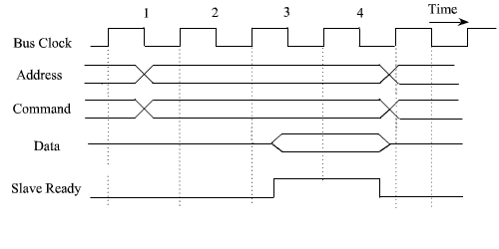
An input transfer using multiple clock cycle

Slide 16
In clock cycle 1, the master sends address and command on the bus requesting a read operation.
The target device responded at clock cycle 3 by indicating that it is ready to participate in the data transfer by making the slave ready signal high.
Then the target device places the data on the data line.

Slide 17
Multiple Cycle Transfer :
The target device is a slower device and it needs two clock cycle to transfer the information.
After two clock cycle, that is at clock cycle 5, it pulls down the slave ready signal down.
When the slave ready signal goes down, the master strobes the data from the data bus into its input buffer.
If the addressed device does not respond at all, the master waits for some predefined maximum number of clock cycles, then aborts the operation.

Slide 18
Asynchronous Bus
In asynchronous mode of transfer, a handshake signal is used between master and slave.
In asynchronous bus, there is no common clock, and the common clock signal is replaced by two timing control signals: master-ready and slave-ready.
Master-ready signal is assured by the master to indicate that it is ready for a transaction, and slaveready signal is a response from the slave

Slide 19
Asynchronous Bus
The handshaking protocol proceeds as follows:
The master places the address and command information on the bus.
Then it indicates to all devices that it has done so by activating the master-ready signal.
This causes all devices on the bus to decode the address.

Slide 20
Asynchronous Bus
The selected target device performs the required operation and inform the processor (or master) by activating the slave-ready line.
The master waits for slave-ready to become asserted before it remove its signals from the bus.
In case of a read operation, it also strobes the data into its input buffer.
The timing of an input data transfer using the handshake scheme is shown in the figure.

Slide 21
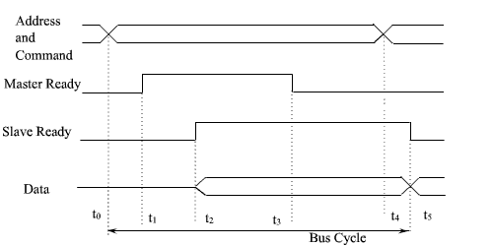
Handshake control of data transfer during an input operation

Slide 22
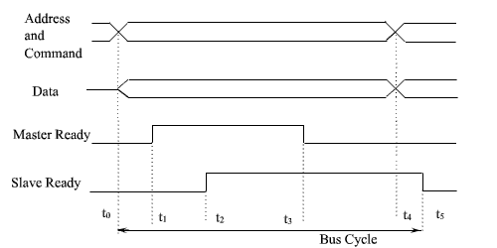
The timing of an output operation using handshaking scheme is shown in the figure.
Handshake control of data transfer during an output operation

Slide 23


